Slide 1

Fraud detection in financial transactions with machine learning
~ Under the guidance of- Prof. Prajyot Patil
Team Members: Shambho Nangare.
Amit Chavan.
Snehal Dimble.
Sayee Gosavi.

Slide 2
PROJECT OVERVIEW
Project Description :
The Project focuses in detecting fraudulent financial transactions using machine learning models. The goal is to create a real-time fraud detection system that minimizes financial losses and improves transaction security.
Goal:
* Identify fraudulent transactions with high accuracy.
* Reduce false positives to enhance user experience.
* Implement a scalable and real-time fraud detection system.
Context:
* Financial fraud is increasing due to the rise in online transactions.
* Traditional rule-based systems fail to detect evolving fraud patterns.
* Machine learning can analyse transaction behaviour to detect anomalies.

Slide 3
PROBLEM STATEMENT
Description of the Problem:
Financial fraud is a significant challenge for banks, payment processors, and online businesses. Fraudulent transactions can lead to substantial financial losses and reputational damage. Detecting fraud in real-time is difficult due to the constantly evolving nature of fraudulent techniques and the sheer volume of financial transactions.
Why is it Important to Address This Issue?
* Protects businesses and customers from financial losses.
* Reduces operational costs associated with fraud investigations.
* Enhances security and trust in digital transactions.
Key Challenges:
* Fraudsters continuously change their techniques.
* The dataset is highly imbalanced (fraud cases are rare).
* Need for high-speed processing to detect fraud in real-time.

Slide 4
DATA-RELATED INF0RMATION
Data Overview:
* The project uses the financial fraud detection dataset from Kaggle
* This synthetic dataset is designed for binary classification, where transactions are labelled as fraudulent (1)
or non-fraudulent (0).
Data Structure:
* Number of Records: 6362620
* Number of Columns: 11
Data Source:
* Kaggle

Slide 5
PROJECT FLOW
Problem Identification: Understanding fraud detection challenges.
Data Collection: Collect transaction data from Kaggle.
Data Preprocessing: Handle missing values, normalize data, and balance class distribution.
Feature Engineering: Create fraud-related features such as transaction frequency, amount anomalies, etc.
Model selection & Training: Evaluate Random Forest, XGBoost, and Deep Learning models.
Performance Evaluation: Optimize precision, recall, and F1-score.

Slide 6
METHODOLOGY
What Methods or Techniques Are Being Used?
* Data Preprocessing Techniques: Imbalance Data Handling, Feature Engineering, Anomaly Detection Methods.
* Machine Learning Models: XGBoosts, Random Forest, Neural Network, etc.
* Real-time Processing: Streaming fraud detection using Pub/Sub.
Why Were These Methods Chosen?
* Data preprocessing methods improve fraud detection accuracy by balancing data, enhancing feature representation,
and identifying anomalies in complex transaction patterns.
* XGBoost provides high accuracy and handles imbalanced data well.
* Real-time streaming allows fraud detection at transaction time.

Slide 7
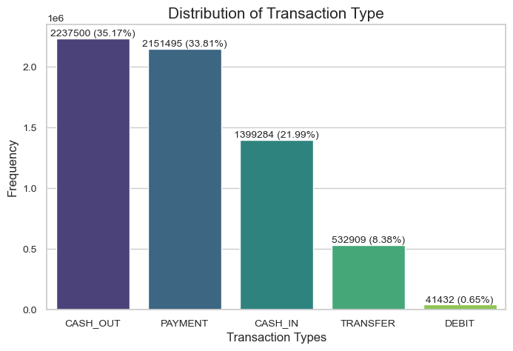
EXPLORATORY DATA ANALYSIS
What types of transactions appear in the datasets and what are their frequencies?
Insights
The most common transaction types are 'CASH_OUT' and 'PAYMENT', while 'TRANSFER' and 'DEBIT' are less frequent.
This pattern might suggest that frauds are likely to occur in specific transaction type (such as 'CASH_OUT' or 'PAYMENT'), as this offer ways to withdraw and or funds.

Slide 8
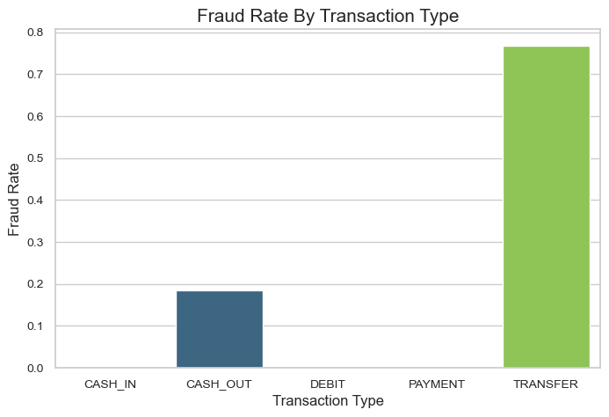
Which transaction type has highest fraud percentage
Insights
It appears that the fraud rate of all transaction types are extremely low, with the highest fraud rate being ~0.75% for TRANSFER. This suggest that fraud is relatively rare across all transaction type, but transfer might be slightly more susceptible to fraudulent activity compared to others.
Given the very low fraud rates, This indicates the highly imbalanced dataset, which is typically in fraud detection problem. This will required techniques like oversampling or anomaly detection during model training to properly identify fraudulent transactions.

Slide 9
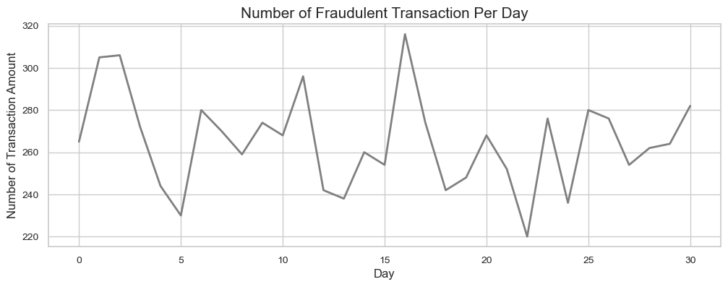
How are fraudulent transactions distributed over time (steps)?
Insights
Consistent Fraud Levels: Fraudulent transaction counts remains stable across days, including steady fraud activity without significant daily fluctuations.
Uniform Fraud Distribution: The absence of extreme peaks or drops suggest that fraudulent activity is evenly distributed, possibly reflecting realistic, continuous fraud attempts rather than event-based spike.

Slide 10
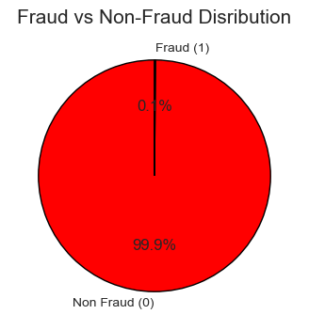
Fraud vs Non Fraud
The dataset is highly imbalanced, with 99.9% of transactions being non-fraudulent and only 0.1% being fraudulent. This severe imbalance can lead to models being biased toward the majority class, causing poor fraud detection.
Handling Imbalance:
Resampling techniques like oversampling (SMOTE) or undersampling can help.
Cost-sensitive learning and anomaly detection methods can improve fraud detection.
Evaluation with precision, recall, and F1-score is necessary since accuracy alone is misleading in imbalanced data.

Slide 11
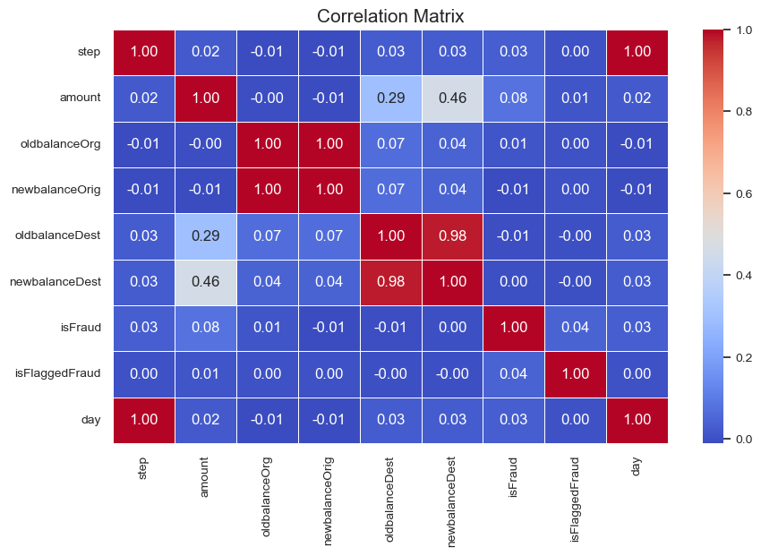
Correlation Analysis
The correlation matrix shows that oldbalanceDest and newbalanceDest have a very high positive correlation (~0.98), meaning they are almost identical. Similarly, oldbalanceOrg and newbalanceOrg have a weaker correlation. Amount has a moderate correlation with newbalanceDest (~0.46). isFraud has weak correlations with all variables, suggesting that fraud detection may rely more on non-linear patterns rather than simple correlations.

Slide 12
CONCLUSION
Random Forest: Accuracy: 99.95%
Reliable but slightly less effective than XGBoost.
XGBoost: Best-performing model with 99.99% accuracy, precision, recall, and F1-score.
Almost no false positives or false negatives.
Most efficient model for fraud detection.
Conclusion & Recommendation:
XGBoost is the best model for deployment due to its perfect classification performance.
Random Forest is a strong alternative with high accuracy.
Final Decision: Deploy XGBoost for optimal fraud detection results

